Slide 1
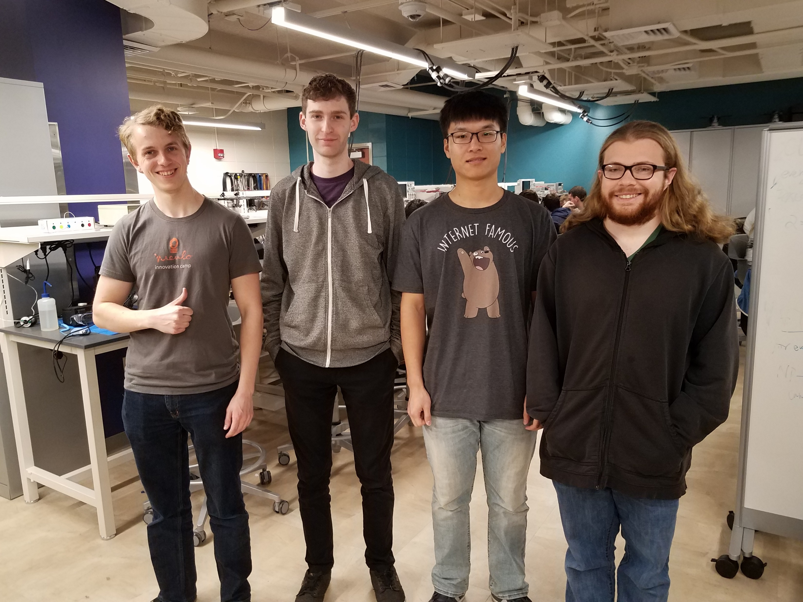
ECE 477 MIDTERM DESIGN REVIEW
Team 16 : Track-On-Track

Slide 2


OUTLINE
Project Overview
Major Components
Block Diagram
Packaging Design
Electrical Schematic
PCB Layout
Prototyping Progress
Software Development Status
Project Timeline
Questions

Slide 3
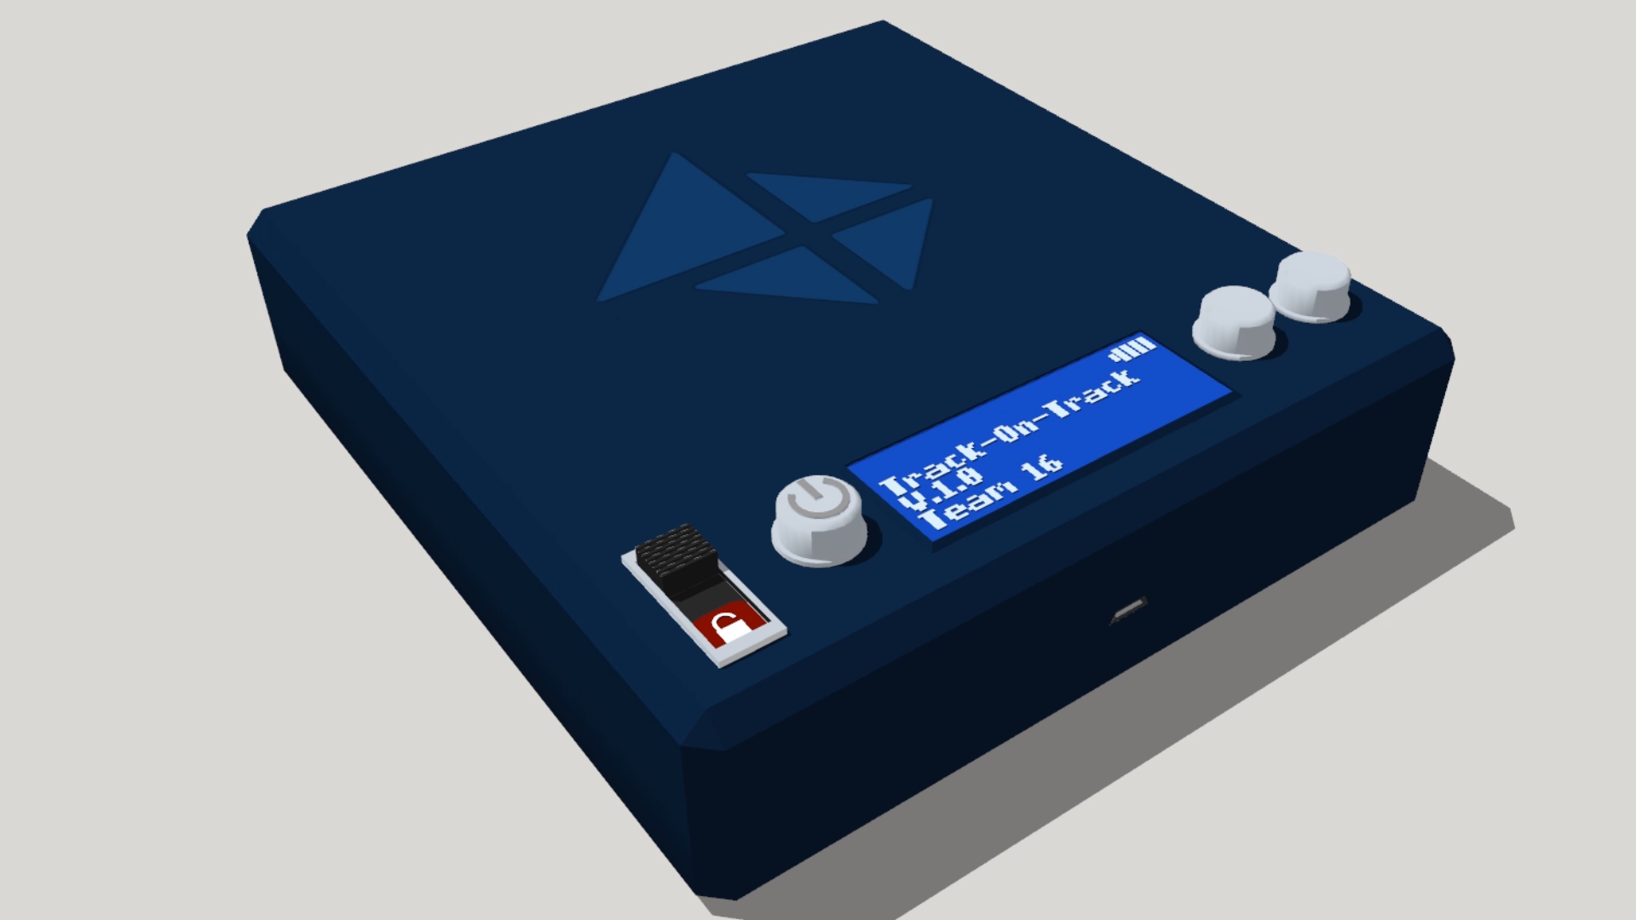
PROJECT OVERVIEW
Device which is able to find its own location using assisted GPS from an onboard cell modem.
Device can also use Bluetooth which can be used to approximate distance based on strength of signal.
Device is designed to fit into backpack or luggage and transmit its location to user’s smartphone through SMS messages, and can communicate at close range using Bluetooth.
Once smartphone receives GPS coordinates, it will plot those onto a Google Maps display to show user exact location of their belongings.

Slide 4
PSSCS
An ability to communicate with the user through Bluetooth in short distances.
An ability to communicate with the user through a cell modem over SMS in long distances.
An ability to display operating mode, battery life, and cell signal through an LCD.
An ability to detect the devices location.
An ability to control the device through a smartphone application.

Slide 5
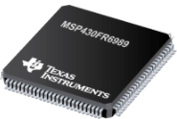
MAJOR COMPONENTS: Microcontroller
MSP430FR6989 selected as microcontroller for project
128 kB FRAM, 2 kB RAM, .375 mA @ 1 MHz, 2 UART, 4 SPI, 83 pins.
Chosen because it is very power efficient while still having enough memory and speed to perform required processes

Slide 6
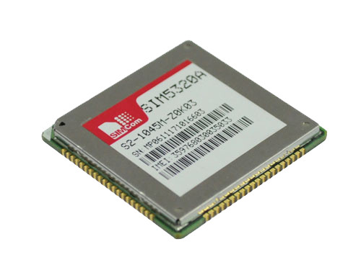
MAJOR COMPONENTS: Cell Modem
SIM5320A selected as GSM modem for our project
Supports 2G and 3G connections
Adafruit breakout board available
Built in support for variety of protocols including SMS, MMS, HTTP, FTP, SSL, DNS
Chosen because of flexibility of the component along with example code and board

Slide 7
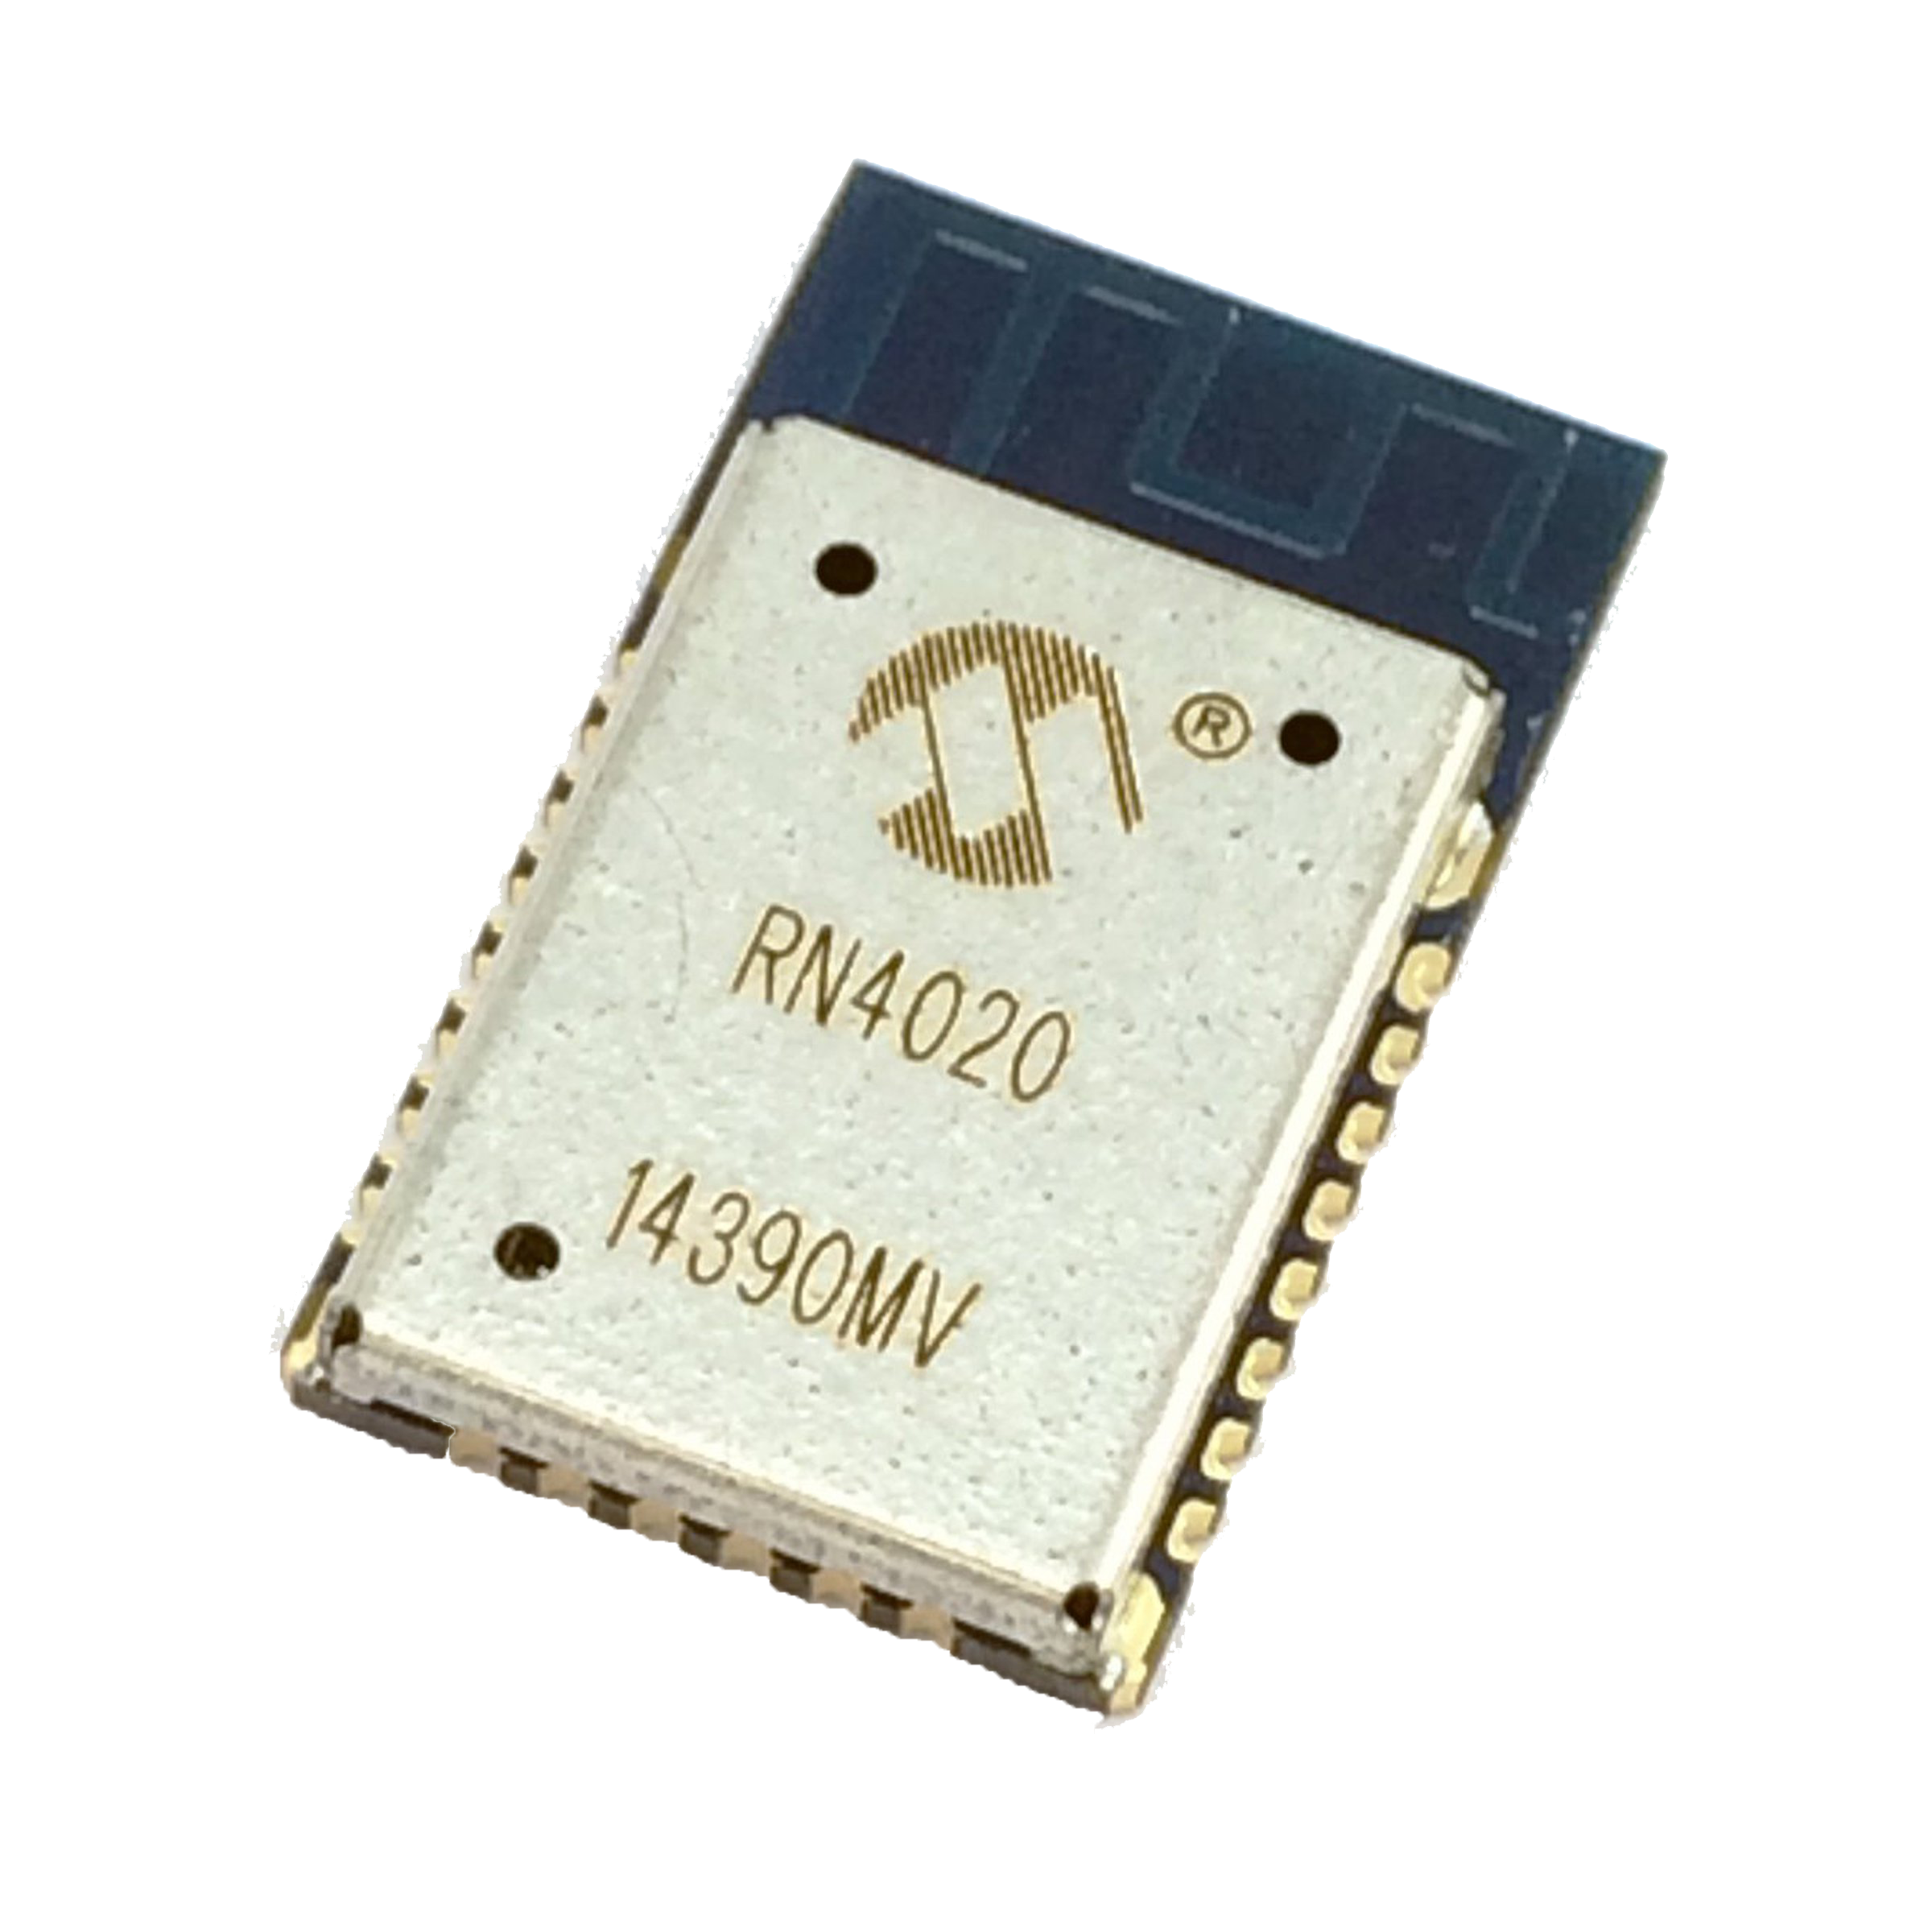
MAJOR COMPONENTS: Bluetooth
RN4020 chosen as bluetooth module for project
7 dBm, <900 nA while asleep, 16 mA while operating, support SPI and UART, 1 Mb/s transmission
Chosen due to balance between power consumption and transmission power, under optimal conditions, can transmit 100 meters

Slide 8
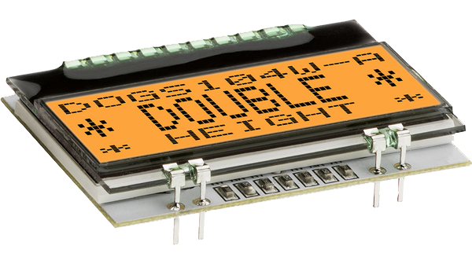
MAJOR COMPONENTS: Display
EA DOGS104W-A chosen as LCD display for our project
Low power consumption (440 µA typical)
Backlight optional
4 lines with adjustable character sets
SPI or I2C interface for simplicity with our microcontroller

Slide 9
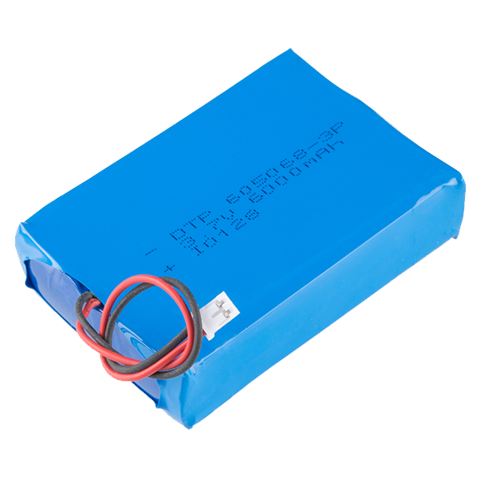
MAJOR COMPONENTS: Battery
PRT-13856 chosen as rechargeable battery for project
3.7 V, 6 Ah, < 150 g, 51 * 73 * 20 mm
Provides enough voltage to run all components
Under minimal use conditions, will power device for approximately 51 days
Weight and size wise, battery is small enough to not impact design considerably

Slide 10

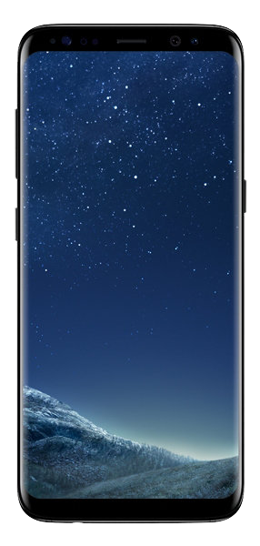
BLOCK DIAGRAM

Slide 11
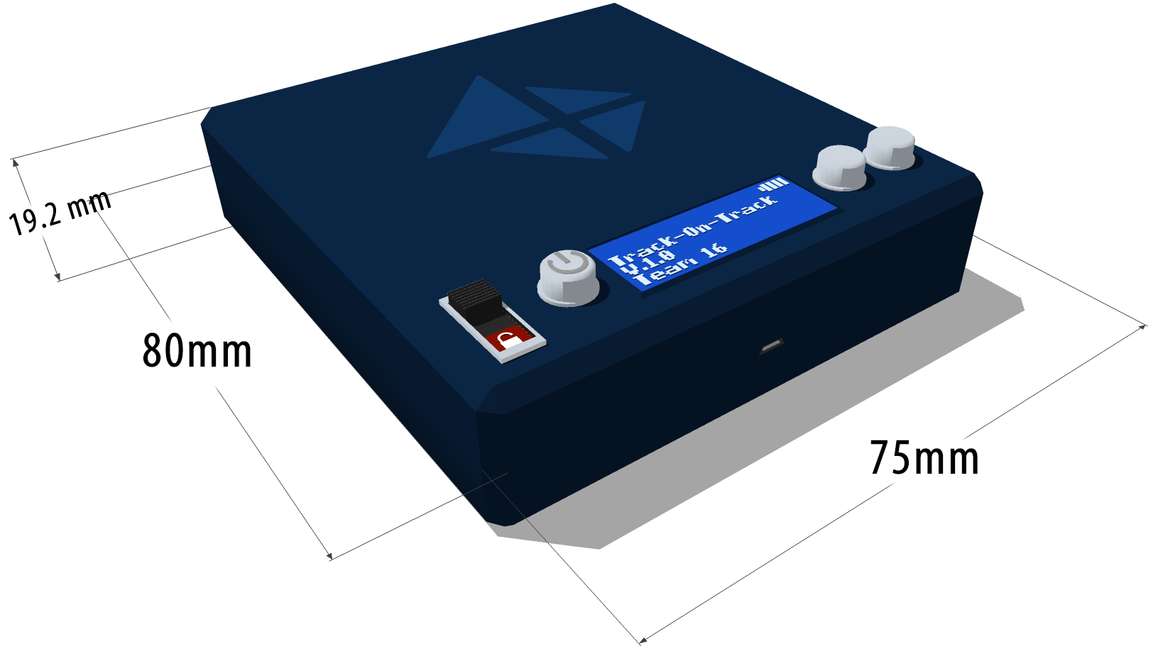
PACKAGING DESIGN
A small box that has openings for LCD, three push buttons, micro USB port, and a switch

Slide 12
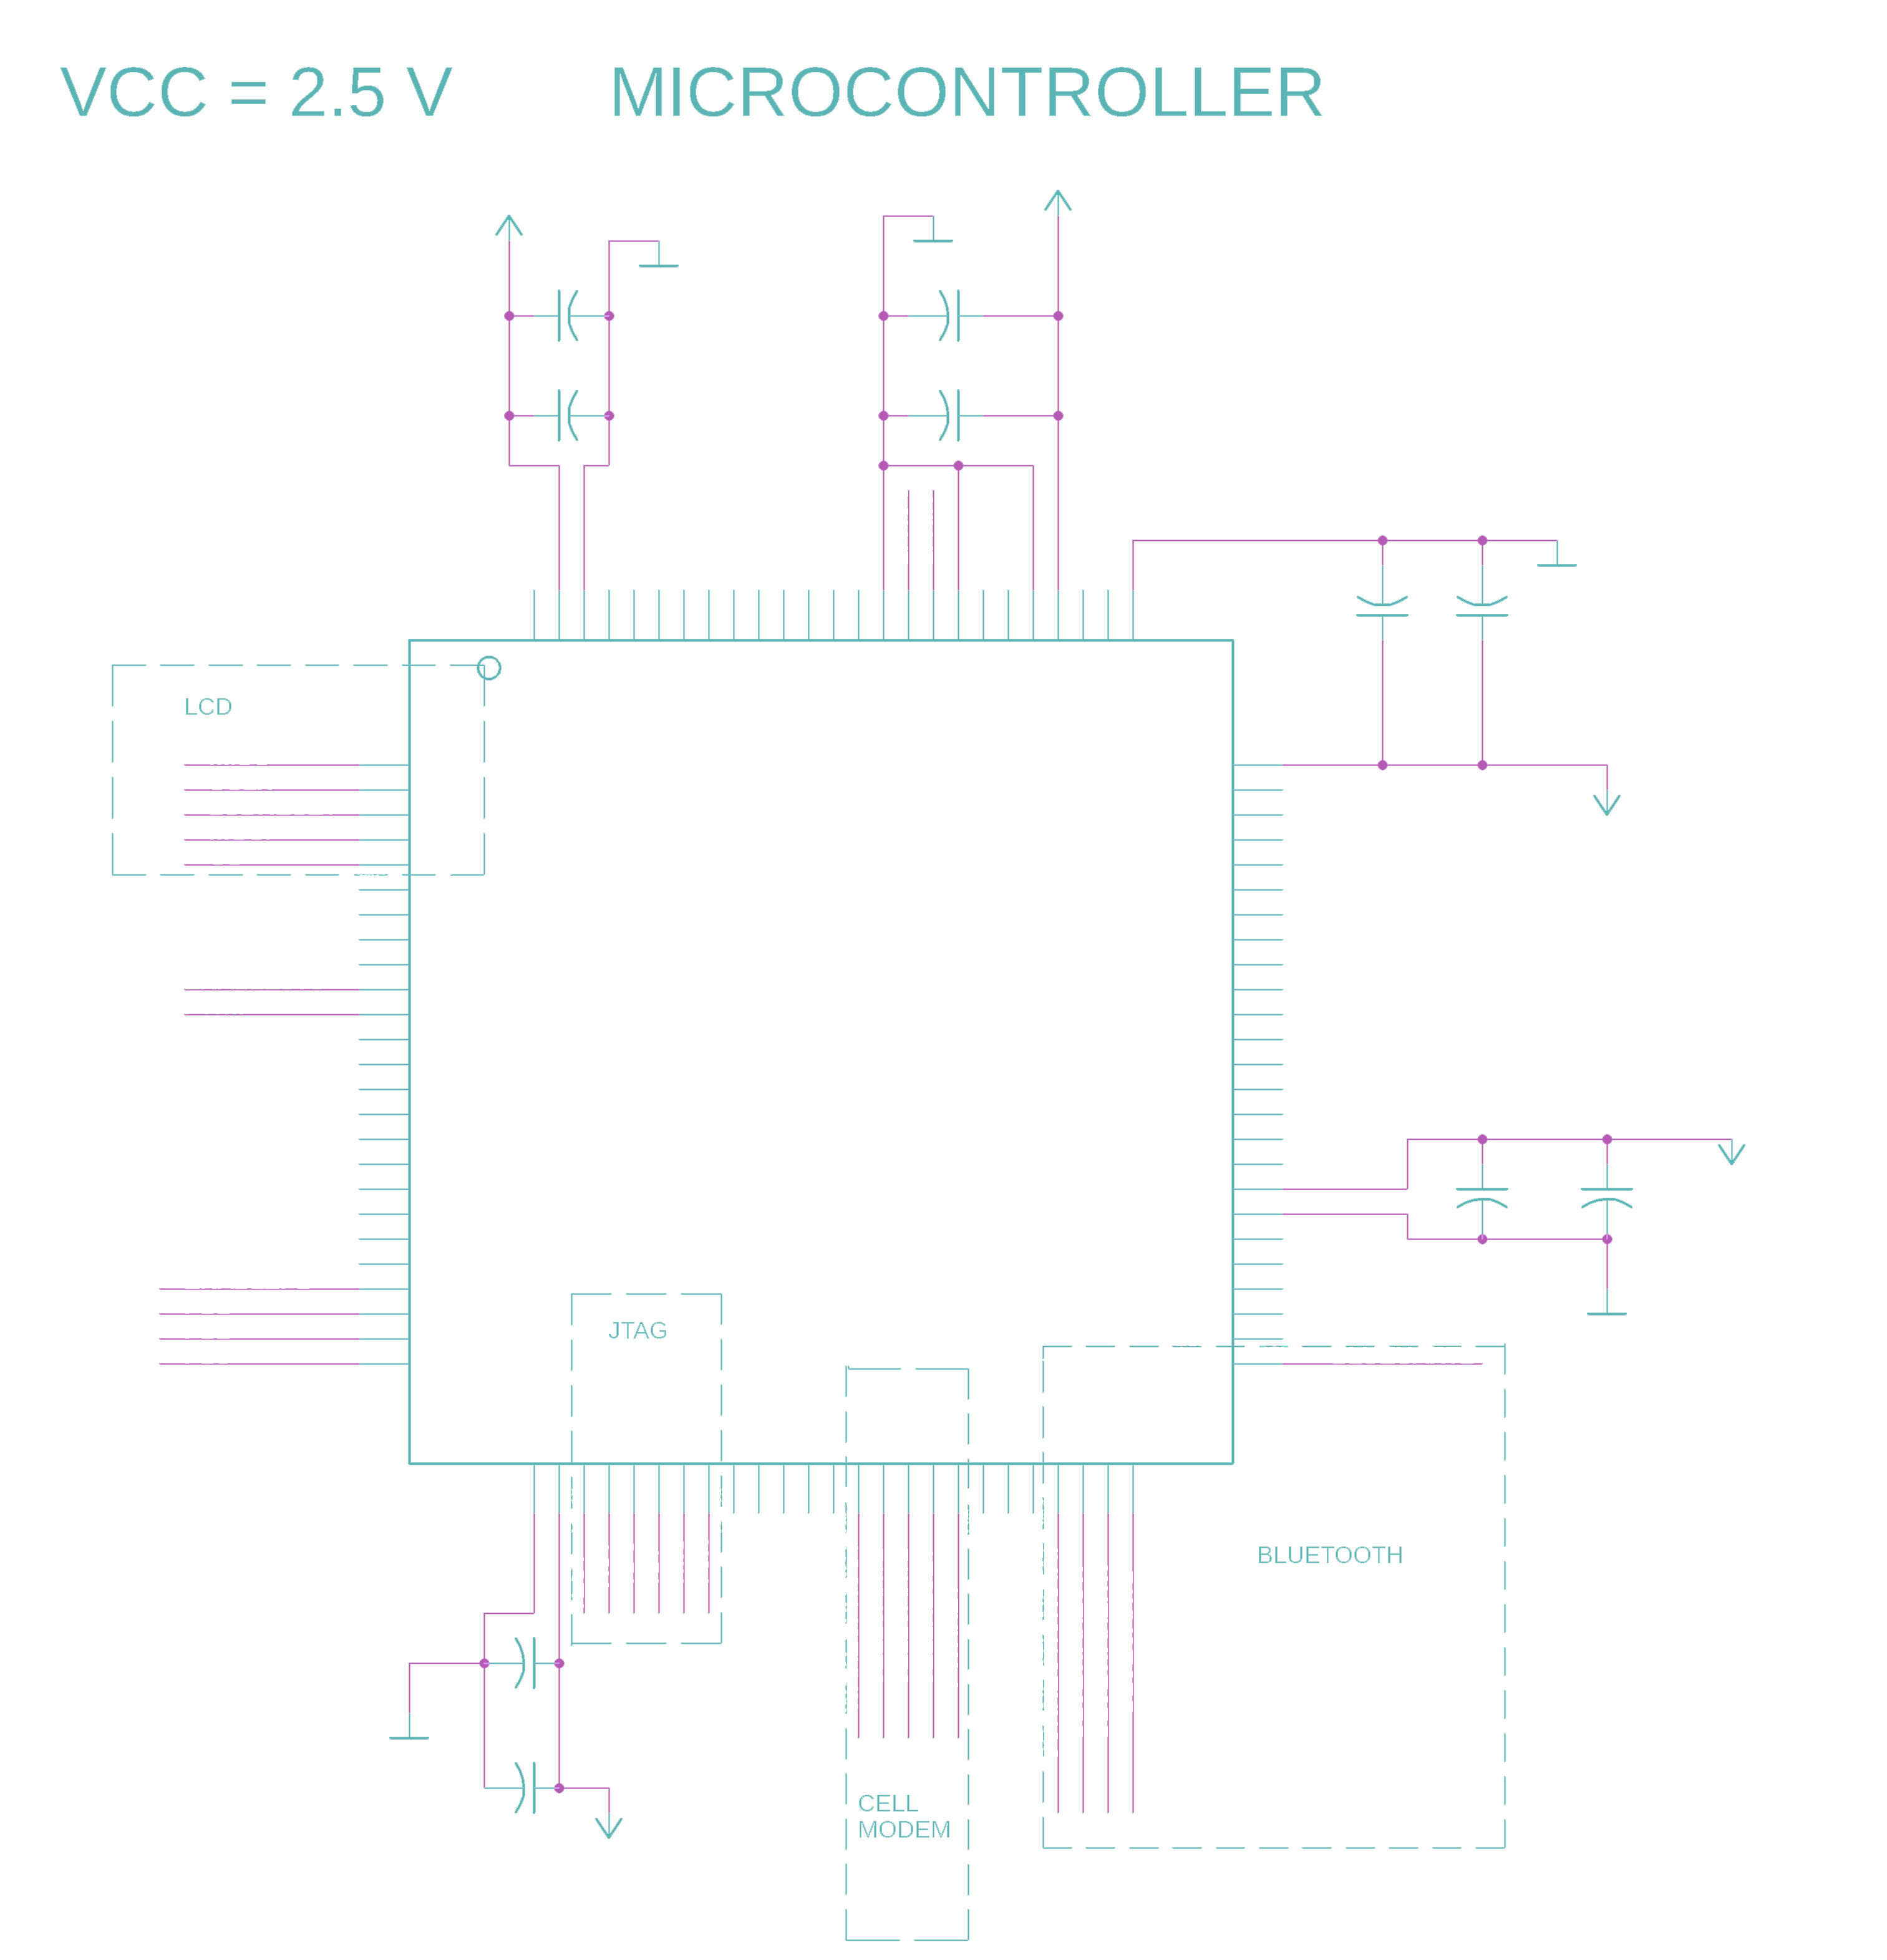
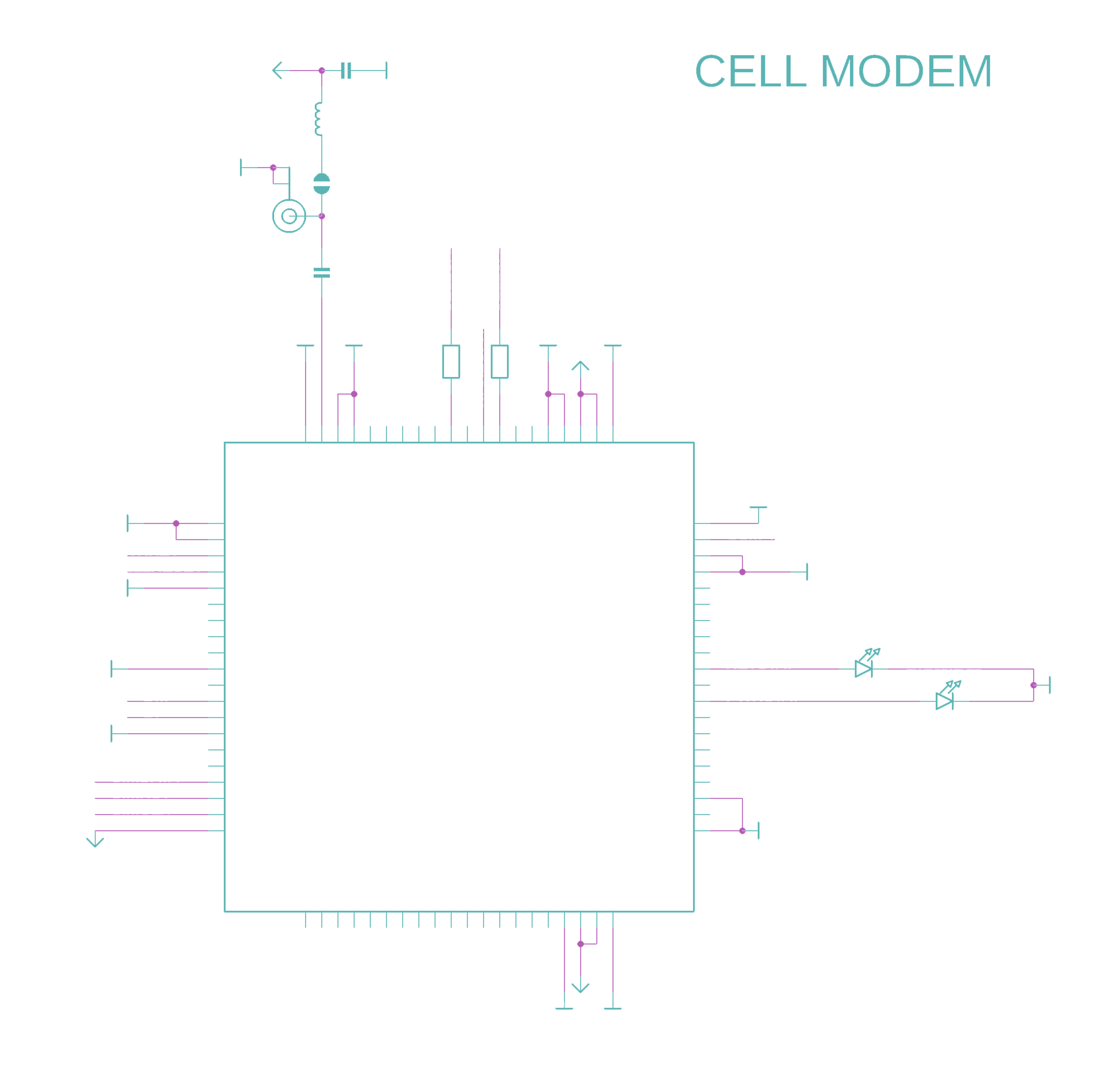
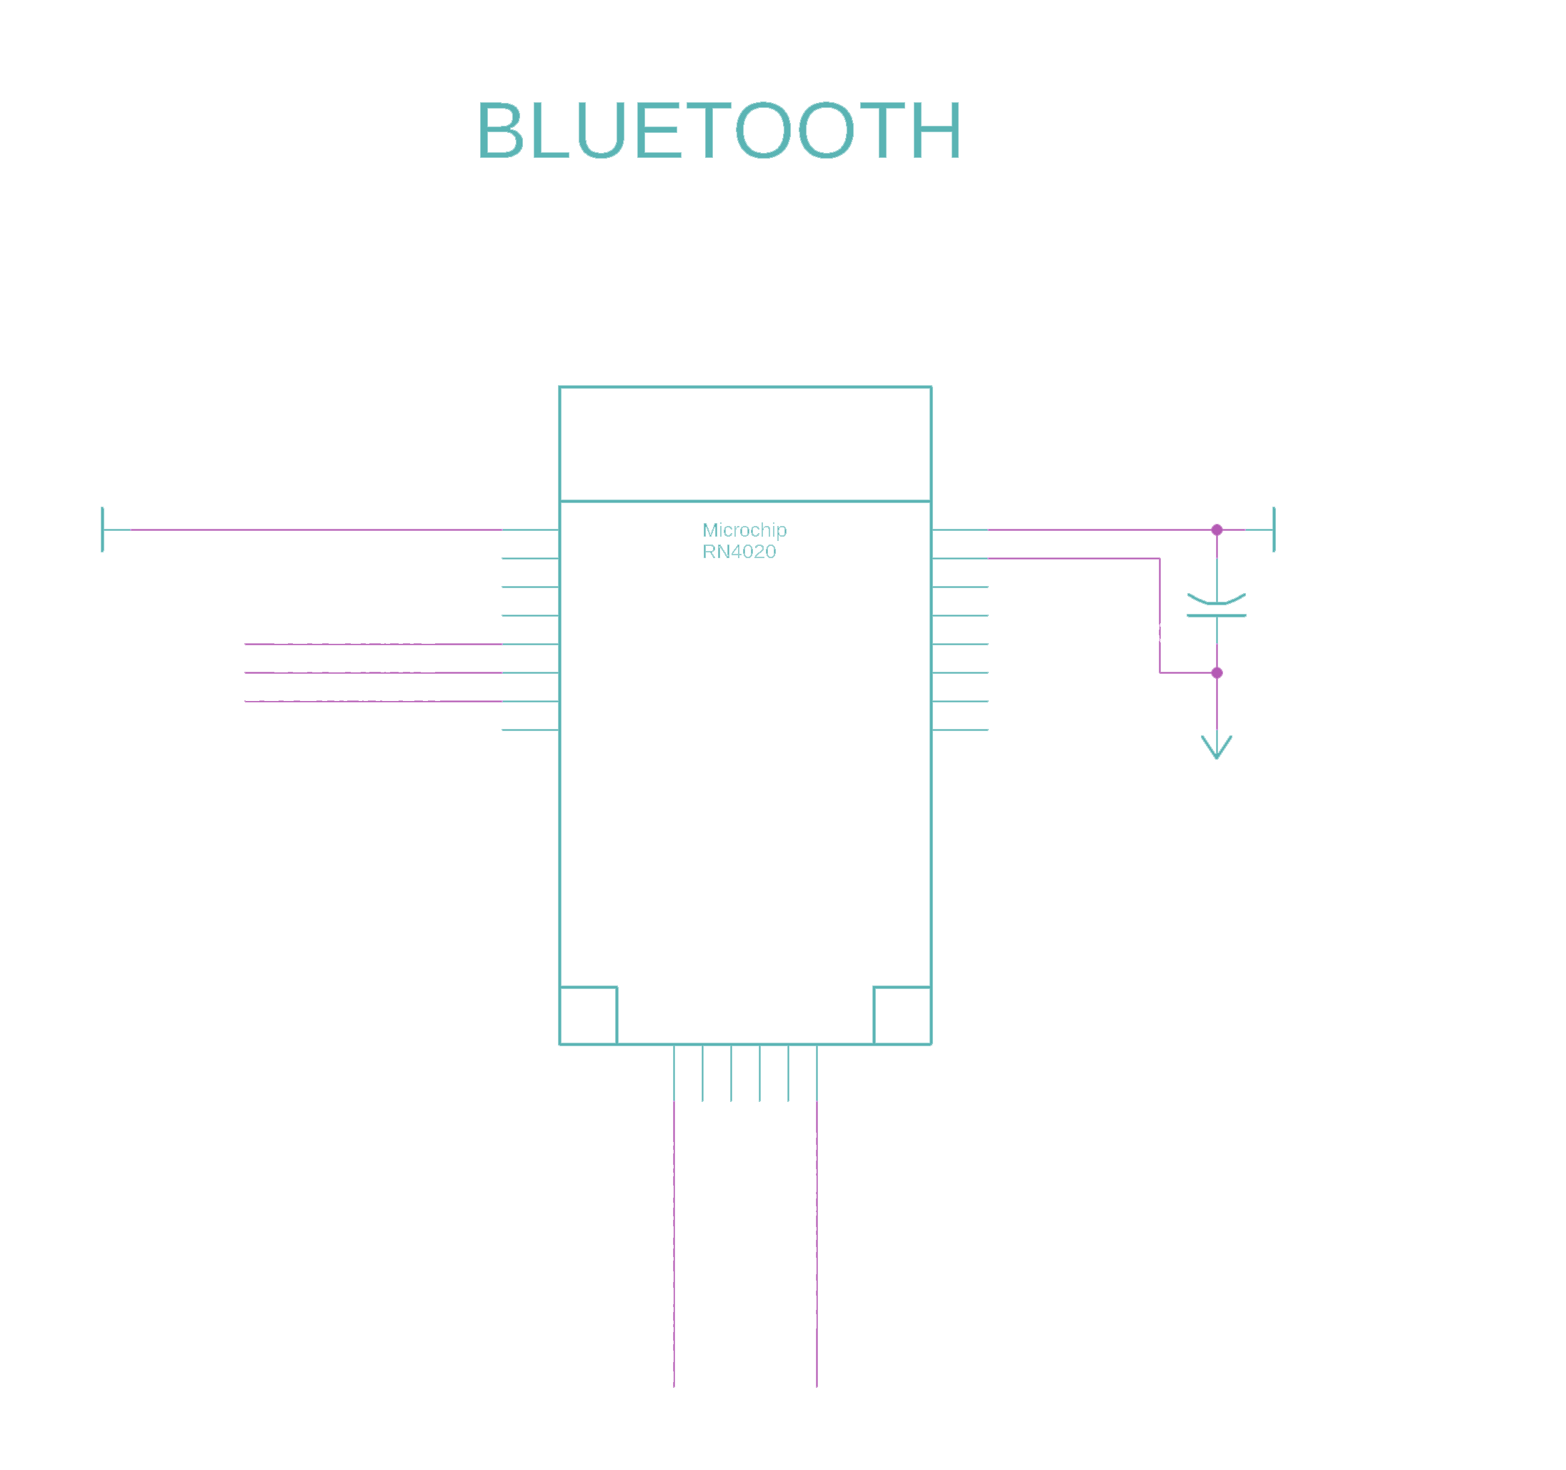
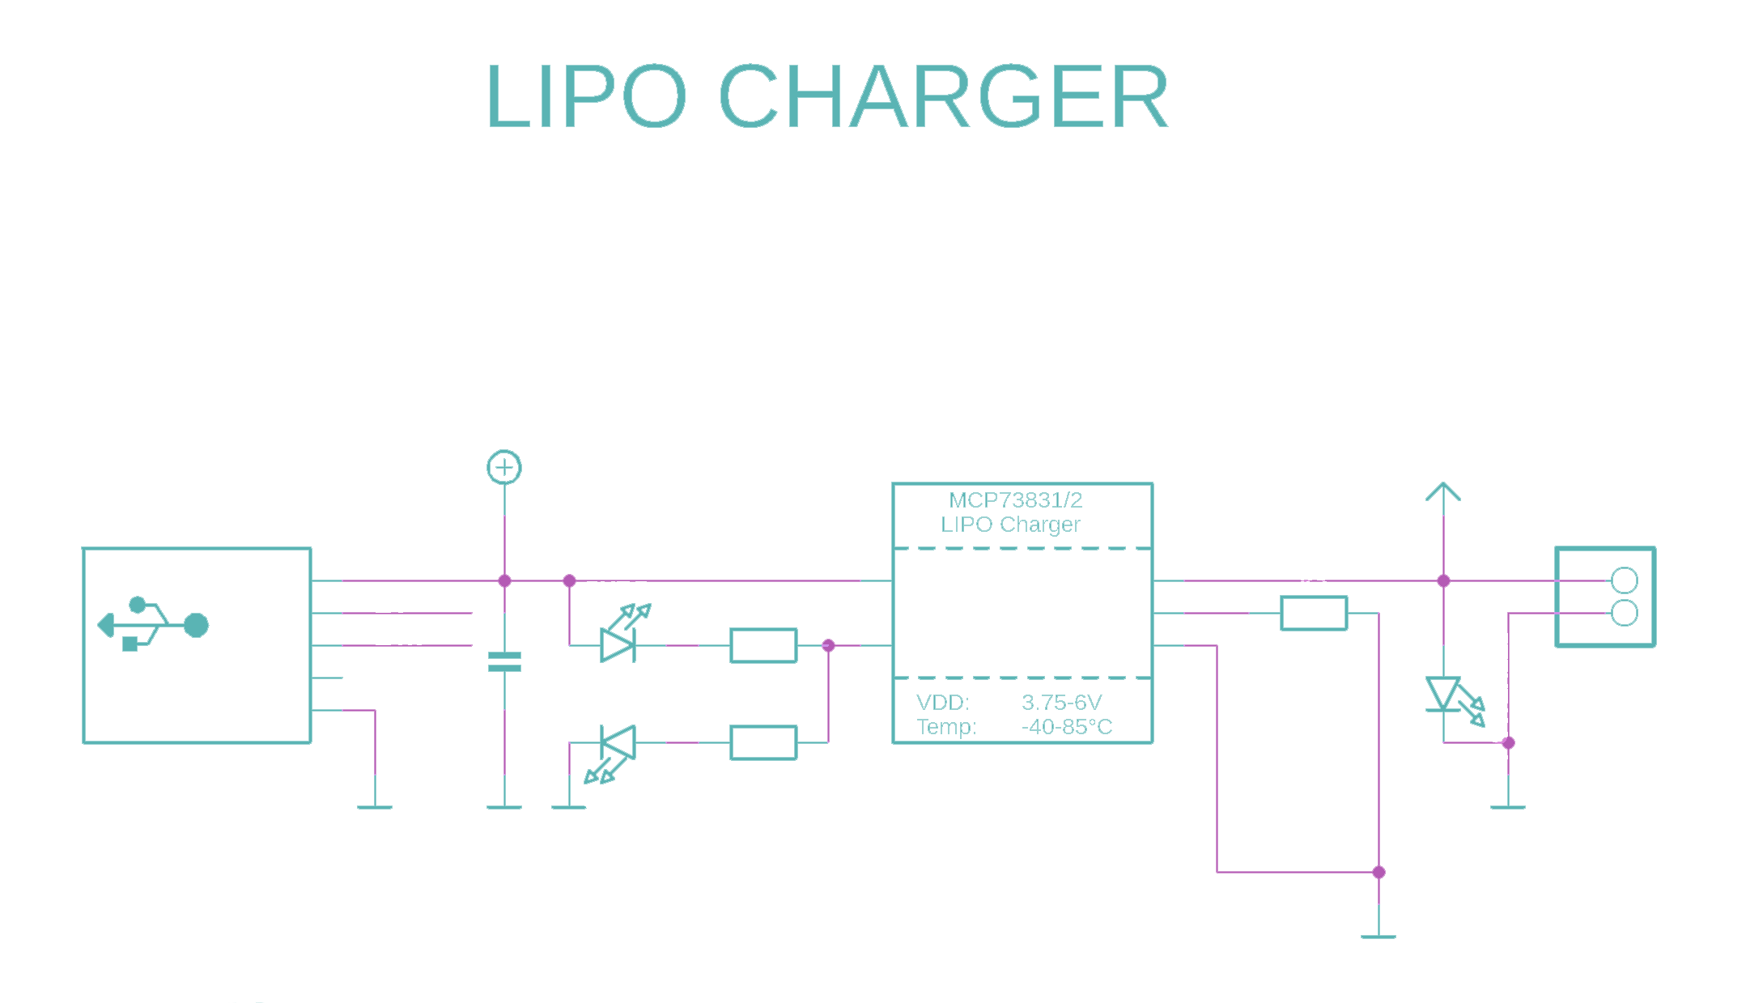
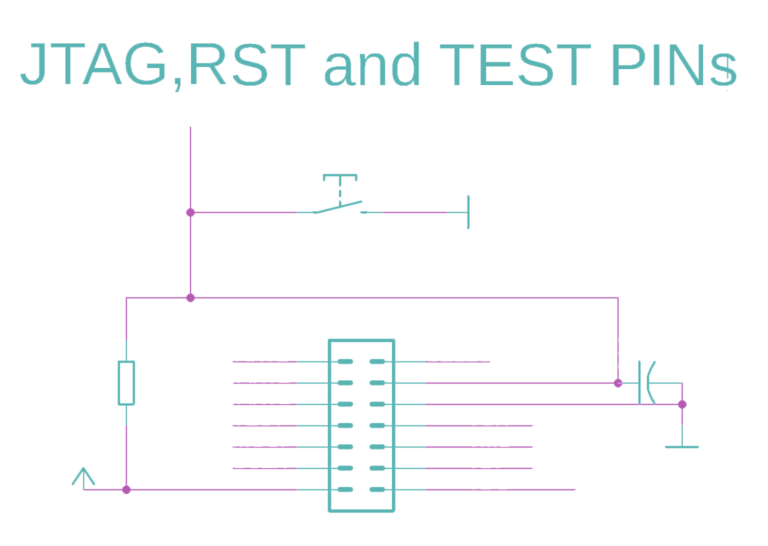
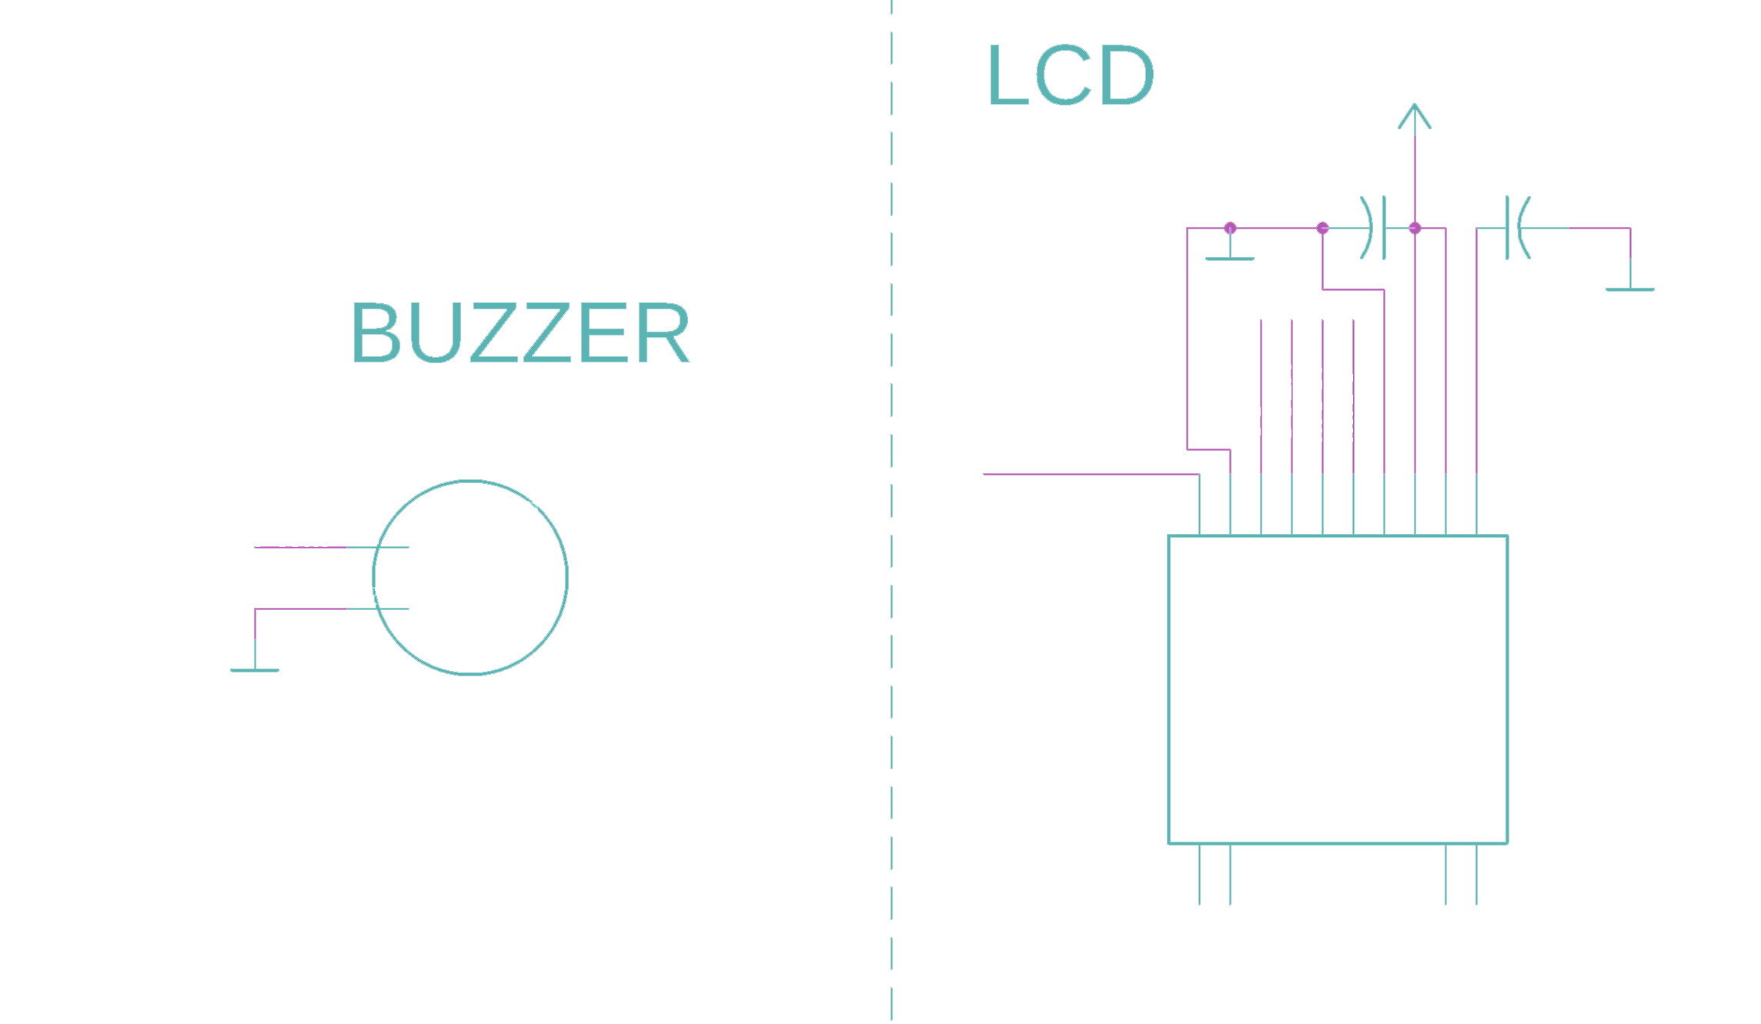
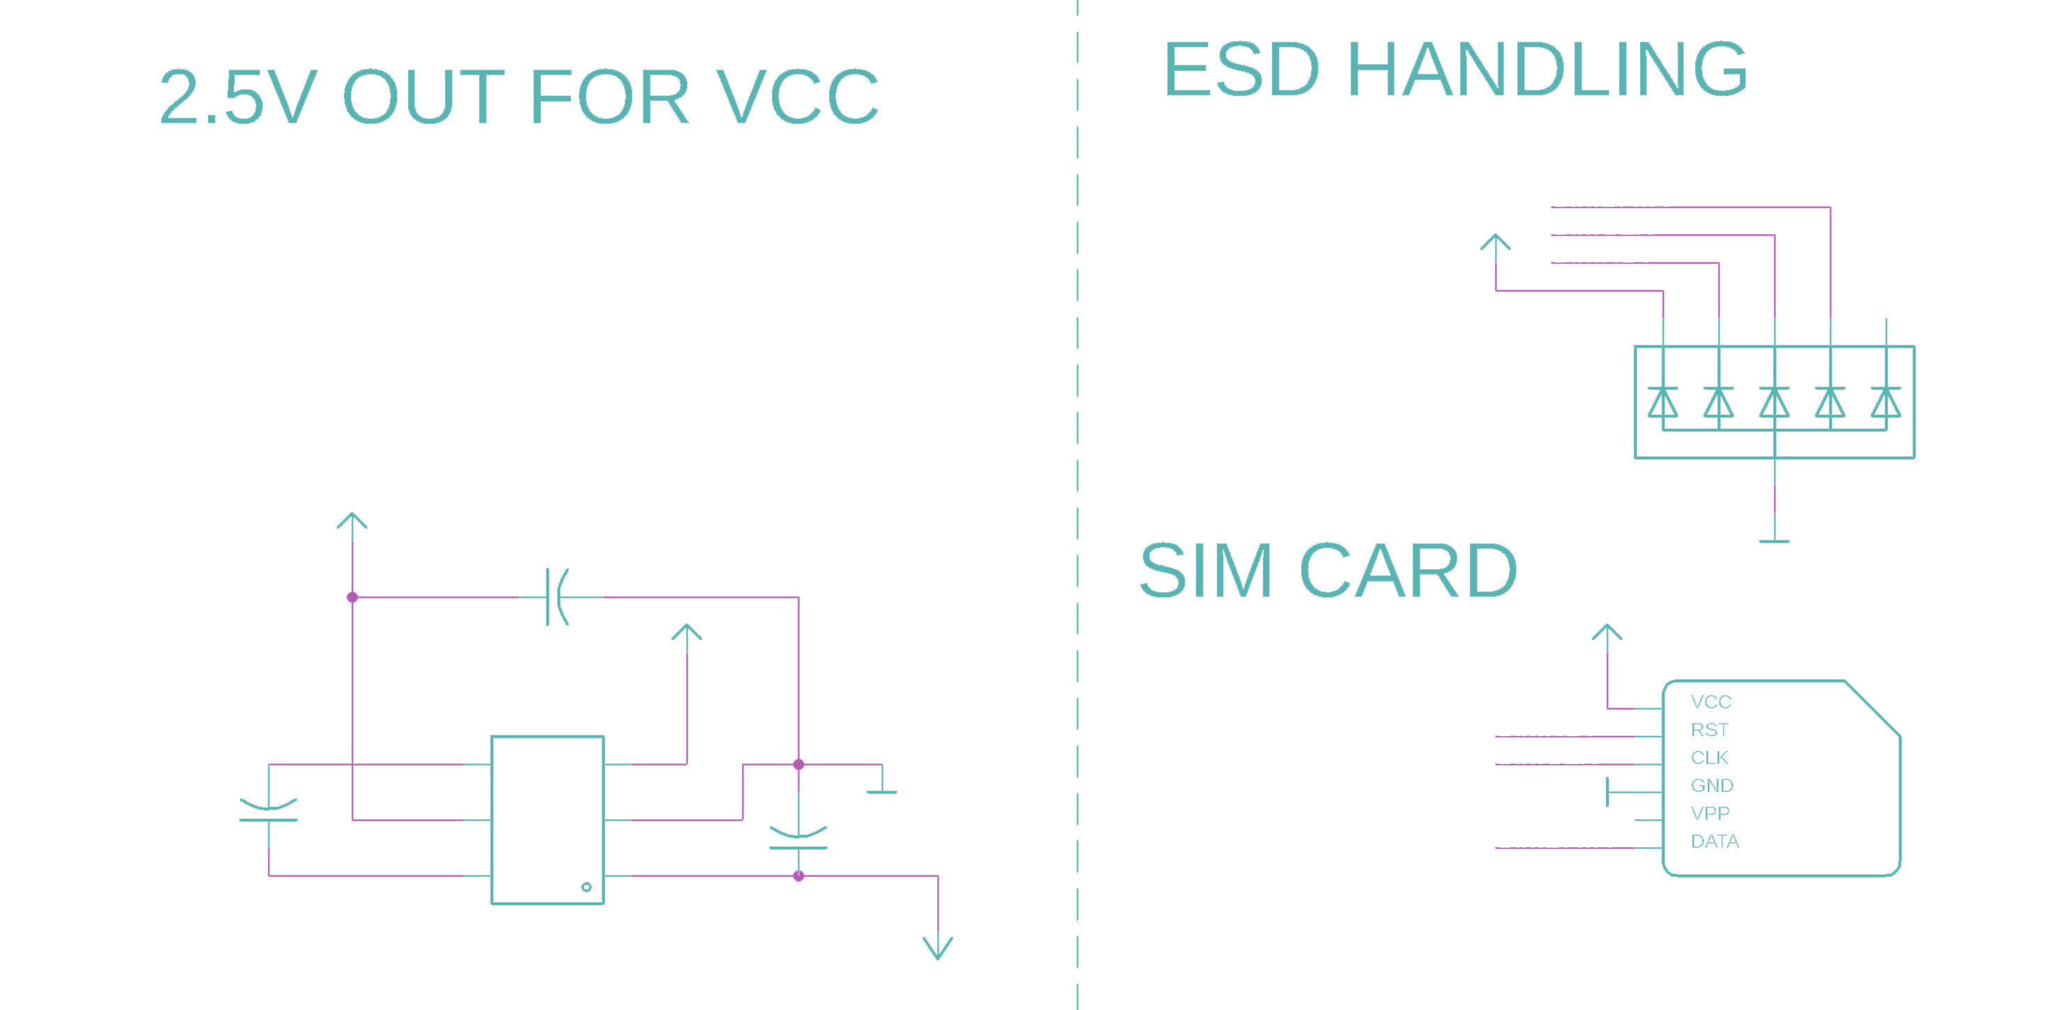
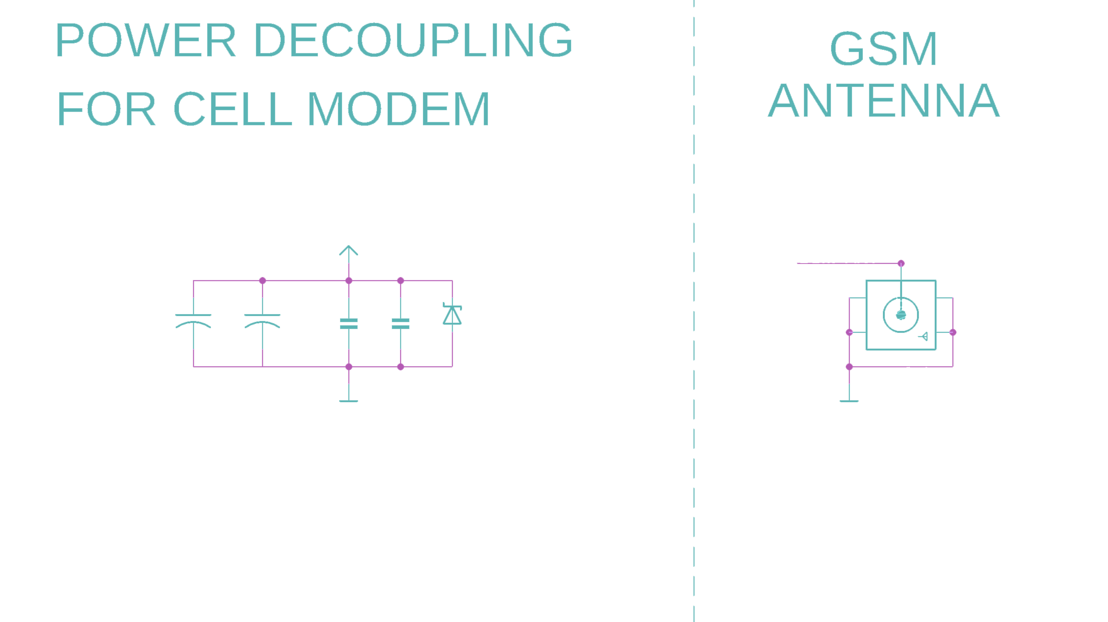
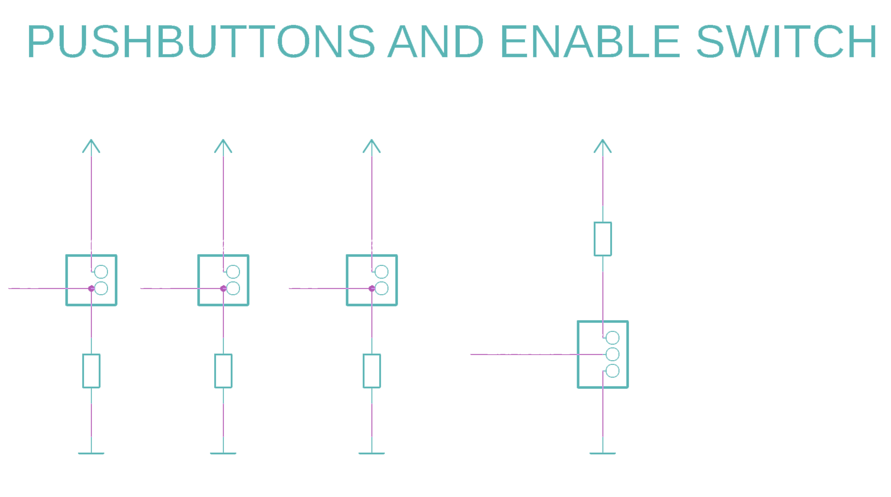
ELECTRICAL SCHEMATIC

Slide 13
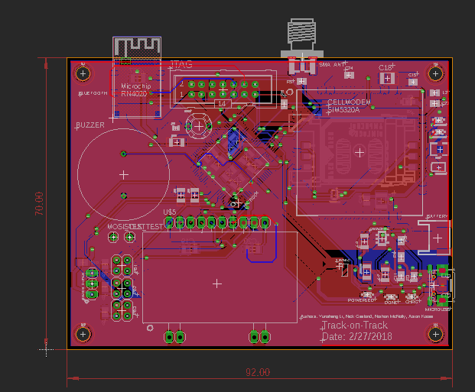
PCB LAYOUT OVERVIEW: Top Layer

Slide 14
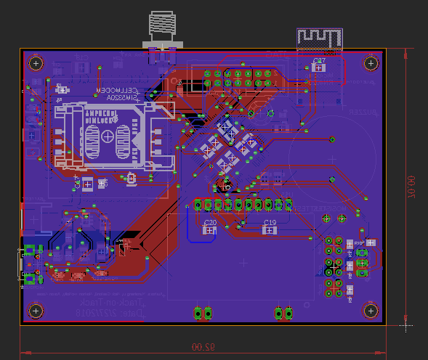
PCB LAYOUT OVERVIEW: Bottom Layer

Slide 15
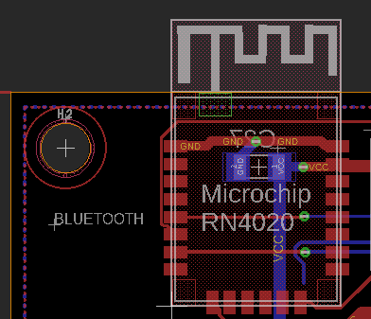
PCB LAYOUT: Bluetooth Module
Decoupling Capacitor
Antenna out of board

Slide 16
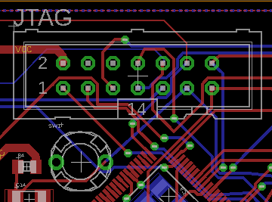
PCB LAYOUT: JTAG and Reset
Unused JTAG pins connected to cell modem UART pins for debugging

Slide 17
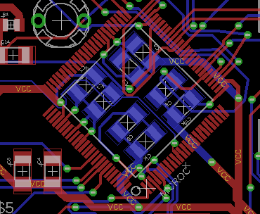
PCB LAYOUT: Microcontroller
Decoupling capacitors placed underneath
No external oscillator needed

Slide 18
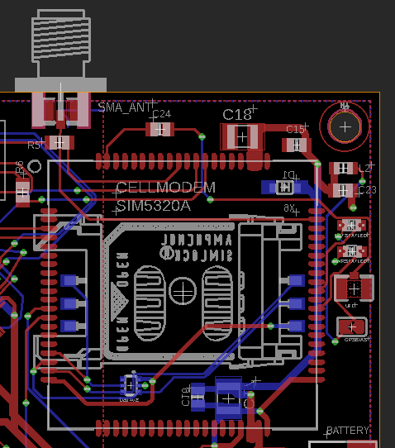
PCB LAYOUT: Cell Modem and SIM
SIM card slot placed under the cell modem
Antenna SMA interface out of board
Antenna U.FL interface placed on another side
Decoupling capacitors

Slide 19
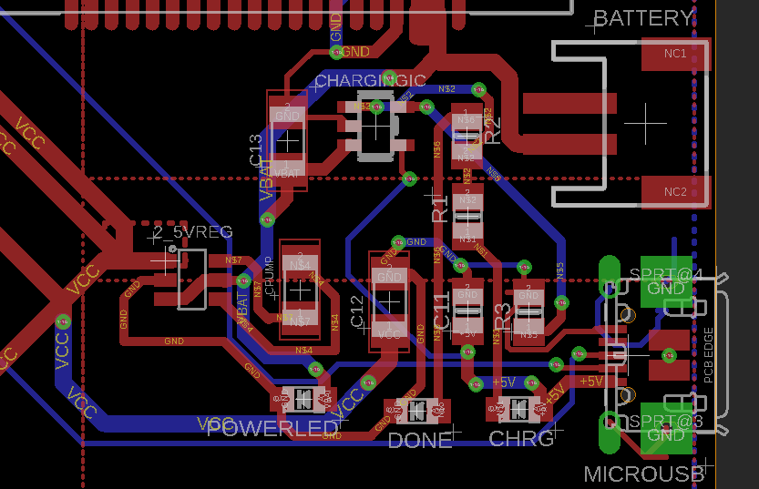
PCB LAYOUT: Power Block
MicroUSB for power input
JST header for battery
On edge of board
Trace width of 32 mils
3 status LEDs

Slide 20
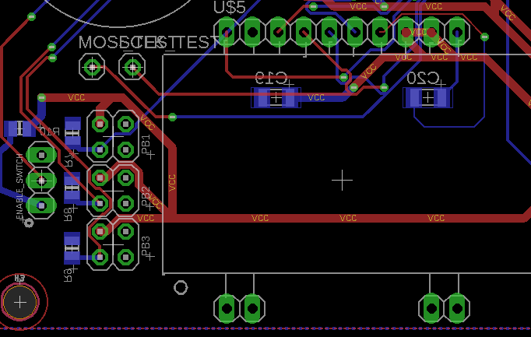
PCB LAYOUT: LCD & Buttons
LCD placed on board for stability
6x6mm pushbuttons to interact with device
Close to edge of board

Slide 21
SOFTWARE DEVELOPMENT PROGRESS
Embedded Software
Send and receive SMS messages from app
Communicate with Bluetooth with app
Respond to commands from device
Smartphone App
Send and receive SMS messages from device
Communicate with Bluetooth with device
Display location of device on Google Maps
Display relative distance based on Bluetooth
Complete
Partially Complete
Incomplete

Slide 22
SOFTWARE DEVELOPMENT PROGRESS
Embedded Software
Ability to receive SMS messages
Read and respond to commands
Receive and translate coordinates
Ability to send SMS messages
Organize and send info to app
Send requests for coordinates
Communicate using Bluetooth
Read and respond to Bluetooth commands
Use speaker and LCD when requested
Respond to physical buttons

Slide 23
SOFTWARE DEVELOPMENT PROGRESS
Smartphone App
Ability to receive SMS messages
Display location on Google Maps
Ability to send SMS commands
Tailor messages via options menu
Communicate using Bluetooth
Send commands using Bluetooth
Display signal strength of Bluetooth

Slide 24
PROJECT TIMELINE
Week 8: Get feedback for PCB, incorporate into design
Week 9: Finish and submit PCB, smartphone app functional for testing
Week 10: Spring Break
Week 11: Receive PCB, solder board, test embedded program
Week 12: Finish main portions of embedded program, begin testing of main features
Week 13: Test full design for vital aspects such as SMS coms and GPS coordinates
Week 14: Finish packaging, finish app, finish embedded soft., test other features
Week 15: Finish all features, test edge cases, find limits of device
Week 16: Design Showcase

Slide 25
QUESTIONS?

